Slide 1
E-JUST Robotics Club
Workshop 2 – Session 1

Slide 2

Table of Contents
1
3
2
IMU
MPU 6050
Detecting acceleration
Arduino Circuit
Communication protocols
4
Arduino Code

Slide 3
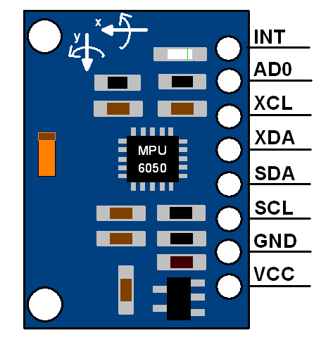
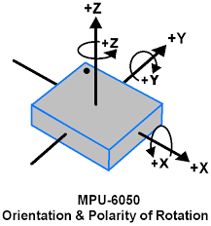
IMU - MPU 6050
Right hand rule

Slide 4
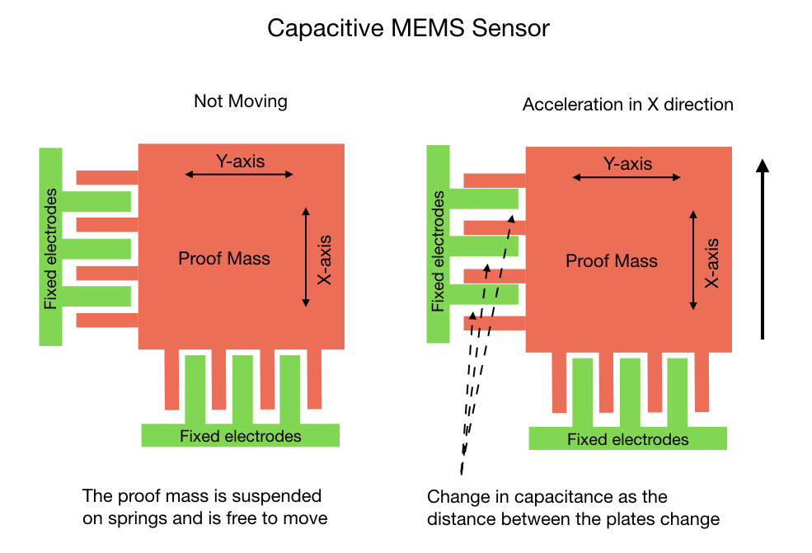
Detecting acceleration in MPU
MEMS: Micro electrochemical system
Acceleration in Y- direction

Slide 5
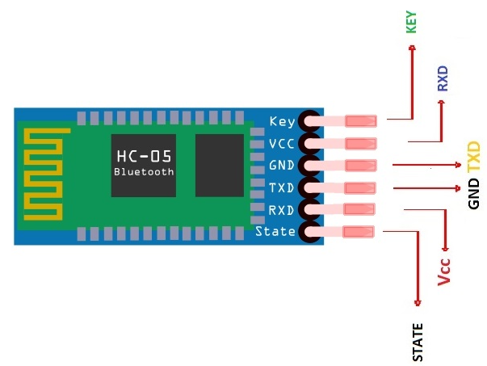
Communication Protocols
USB
SPI
I2C
UART

Slide 6
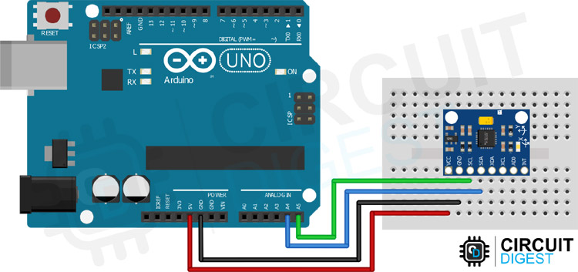
Arduino Circuit

Slide 7
Arduino Code

Slide 8
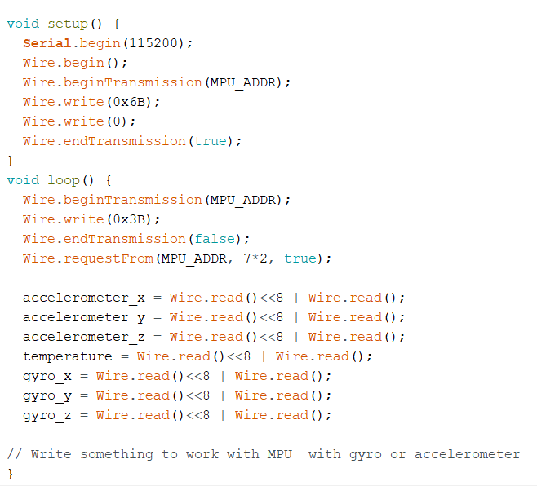
MPU works with 16 bits and Arduino works with 8 so minimize bits used with MPU
Complete the code

Slide 9
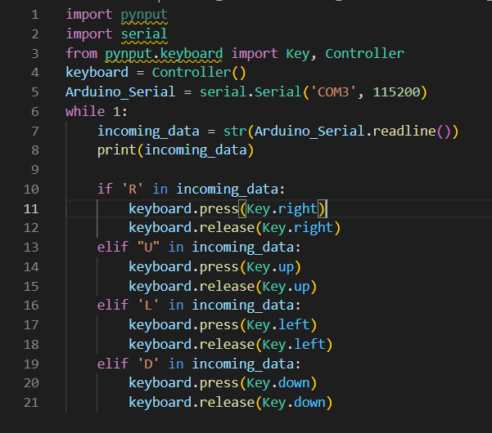
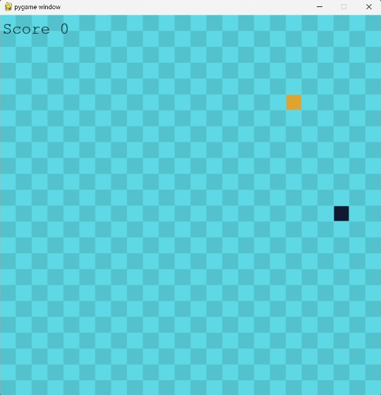
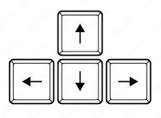

Slide 10
Thanks!

Slide 11
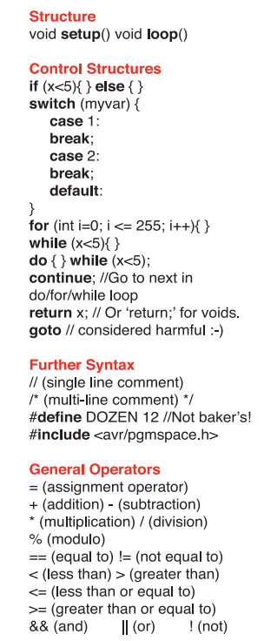
Arduino cheat sheet

